Slide 1
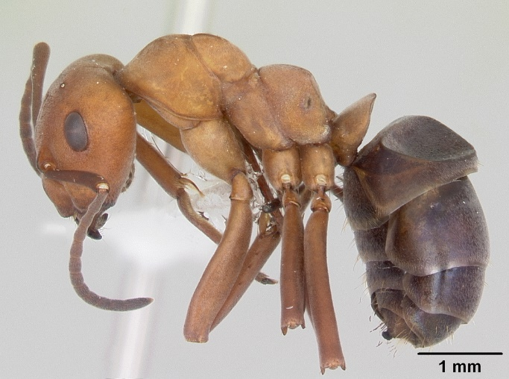
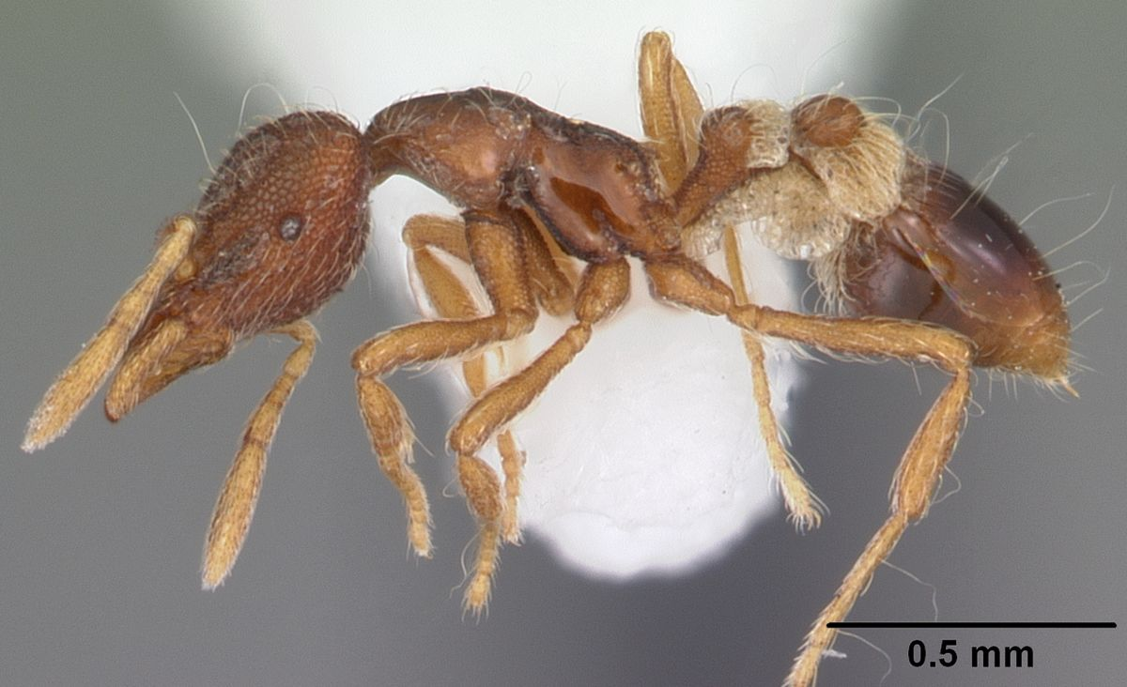
Collection Clinic
Collecting and Retaining Specimens for US Ants
Great Basin, Sonoran, TX/Puerto Rico

Slide 2
You’ve researched your ants – now what?

Slide 3
You’ve researched your ants – now what?
Determine suitable locations to collect from
Don’t forget to get appropriate permissions

Slide 4
You’ve researched your ants – now what?
Determine suitable locations to collect from
Utilize a particular collecting technique
There may be notes out there (i.e., scientific literature, ant blogs, ant wiki, etc.) for successful techniques employed by others!

Slide 5
You’ve researched your ants – now what?
Determine suitable locations to collect from
Utilize a particular collecting technique
There may be notes out there (i.e., scientific literature, ant blogs, ant wiki, etc.) for successful techniques employed by others!
If not, genus might be a good way to go!

Slide 6
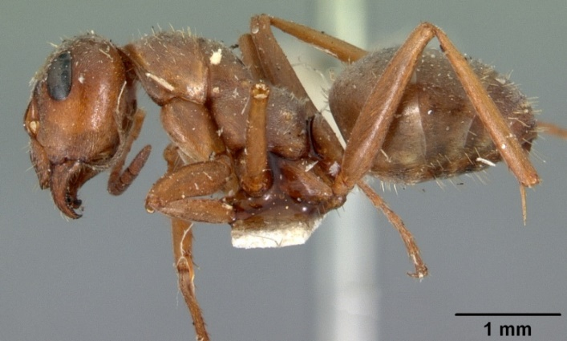
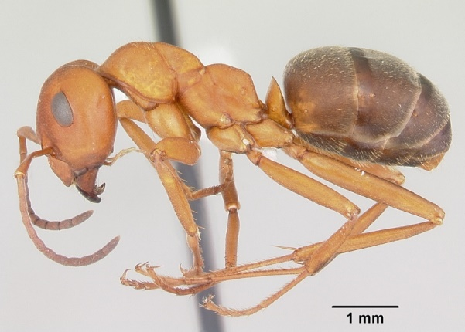
Ant Collecting by Genus
Formica canadensis
Formica montana
Formica ciliata

Slide 7
Ant Collecting by Genus
Formica canadensis
Formica montana
Formica ciliata
Ants placed within the same genus may share behavioral (i.e., feeding) tendencies, nest-building habits, etc.

Slide 8
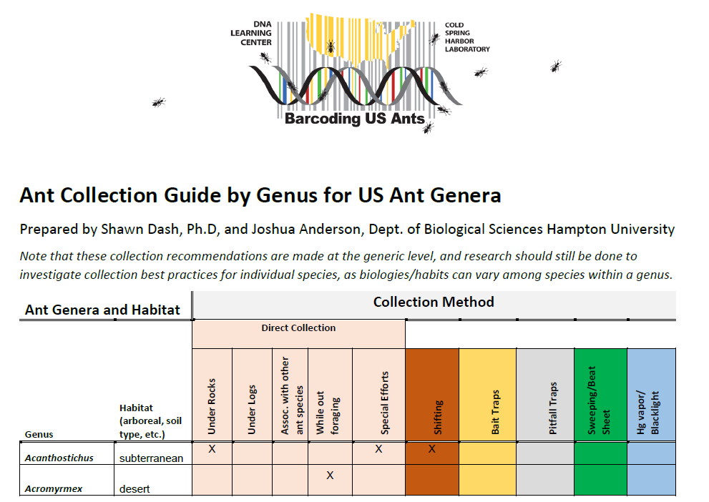
Consult the Collection by Genus Guide
Will be up in dropbox

Slide 9
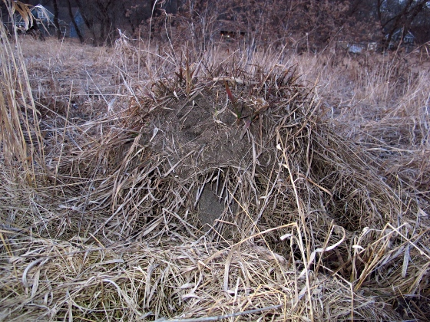
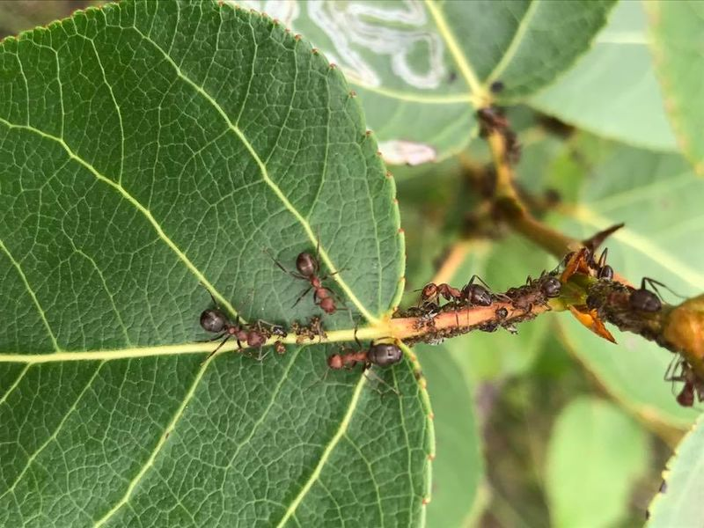
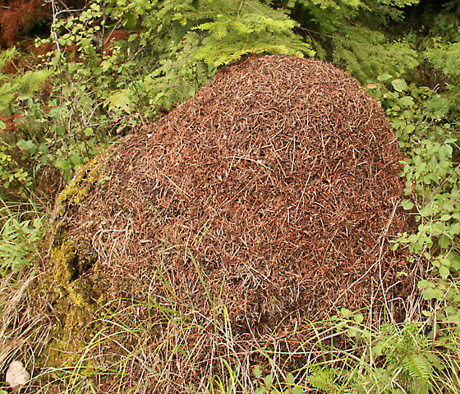
Formica spp.
Notes:
Wood ants, field ants, mound-building ants
Nests in ground (sometimes under stones, sometimes above ground, covered with “thatching”)
Often temperate forest understory dwellers
Predatory, but foraging from canopy for sweets.
F. montana mound
F. obscuriventris
Host of Formicoxenus hirticornis, btw
F. obscuripes mound

Slide 10
Formica spp.
How to collect?
Baiting – pecan sandies, tuna, crushed crickets (remember predatory)
Nests (sometimes) easy to see – directed hand collecting
Sweeping/beat sheeting low vegetation
Leaf litter/soil sifting may be better for some species.
Pitfalls
Notes:
Wood ants, field ants, mound-building ants
Nests in ground (sometimes under stones, sometimes above ground, covered with “thatching”)
Often temperate forest understory dwellers
Predatory, but foraging from canopy for sweets.

Slide 11
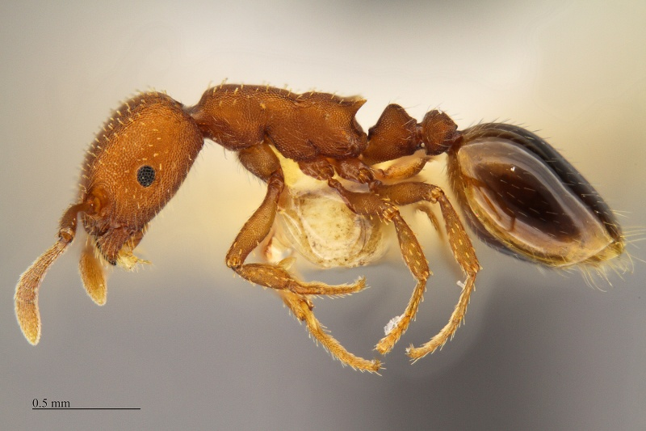
*Formicoxenus hirticornis
How to collect?
Identify nests of host (like Formica obscuripes)
Sample from nest – excavation may be required
Notes:
Xenobiont within Formicine nests.

Slide 12
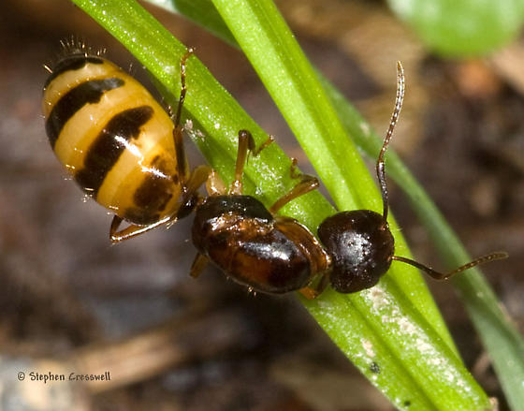
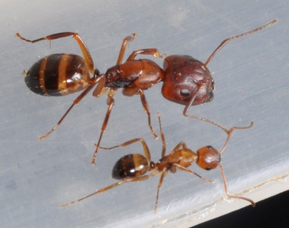
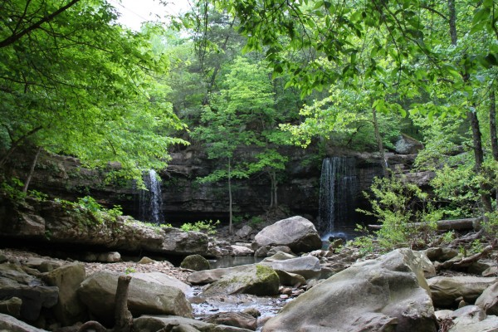
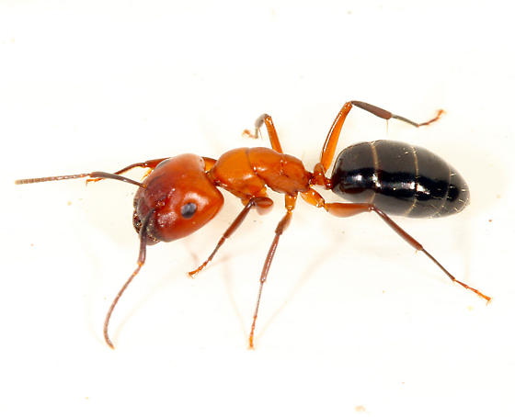
Camponotus spp./Colobopsis spp.
Notes:
So-called carpenter ants
Nest in decaying wood (moist or dry)
Often temperate forest understory or field fringe dwellers
Predatory/scavenging, but foraging from canopy for sweets, and frequently visiting flowers
Sometimes in soil or partially in soil
Camponotus subbarbatus
Camponotus decipiens

Slide 13
Camponotus spp./Colobopsis spp.
How to collect?
Baiting – pecan sandies, tuna, crushed crickets (remember scavenging)
Pitfalls
Direct hand collecting – under rocks, downed logs/bark
Leaf Litter/soil sifting
Sweeping/beat sheeting fringe flowers
Notes:
So-called carpenter ants
Nest in decaying wood (moist or dry)/under rocks
Often temperate forest understory or field fringe dwellers
Predatory/scavenging, but foraging from canopy for sweets, and frequently visiting flowers
Sometimes in soil or partially in soil

Slide 14
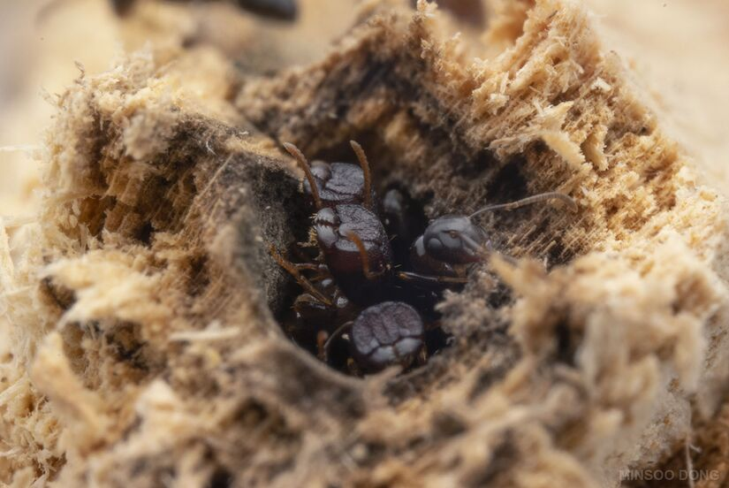
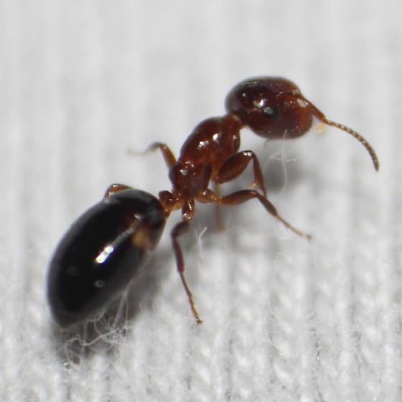
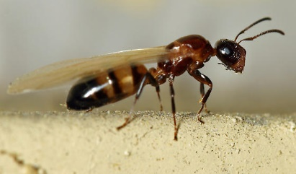
Camponotus spp./Colobopsis spp.
Notes:
Janitor Ants, Plug-head Ants, Gatekeeper Ants
Forest dwellers. Arboreal only.
Nests in twigs (ash or oak), galls, etc.
Scavenging (on droppings, carrion), but foraging from honeydew, nectar, etc.

Slide 15
Camponotus spp./Colobopsis spp.
Notes:
Janitor Ants, Plug-head Ants, Gatekeeper Ants
Forest dwellers. Arboreal only.
Nests in twigs (ash or oak), galls, etc.
Scavenging (on droppings, carrion), but foraging from honeydew, nectar, etc.
How to collect?
Sweeping/beat sheeting
Special efforts - Investigating droppings
Baits?
One of the many reasons why metadata is important!

Slide 16
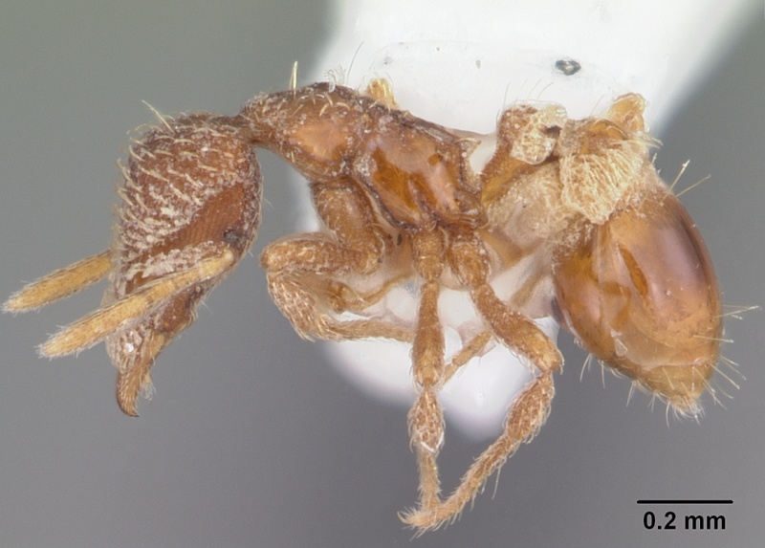
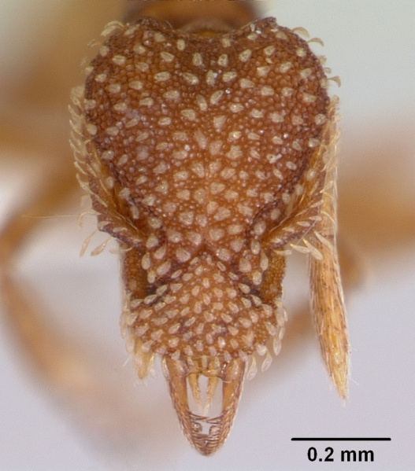
Strumigenys spp.
Notes:
Mini-Trapjaw Ants
A lot of diversity in the southeast!
Soil and leaf-litter dwellers, under rocks, amongst lawn, etc.
Some are predators on springtails!
Forest dwellers.
Often found near Formica or Camponotus nests
S.abdita
S. pergandei

Slide 17
Strumigenys spp.
Notes:
Mini-Trapjaw Ants
A lot of diversity in the Southeast!
Soil and leaf-litter dwellers, under rocks, amongst lawn, etc.
Some are predators on springtails!
Forest dwellers.
Often found near Formica or Camponotus nests
How to collect?
Soil sifting is the way to go for these guys (Berlese, etc.)
Direct hand collecting – longshot.

Slide 18
You’ve researched your ants – now what?
Determine suitable locations to collect from
Utilize a particular collecting technique
Collect ants!!!!
If possible, collect a small series (5-10 ants). If not, 1 ant is better than nothing, but be sure to photodocument!
Store in > 95% EtOH for barcoding.
Otherwise, stick in freezer, but 95% EtOH for longterm.
Retain all ant samples, and amplified DNA.
Collect metadata!

Slide 19
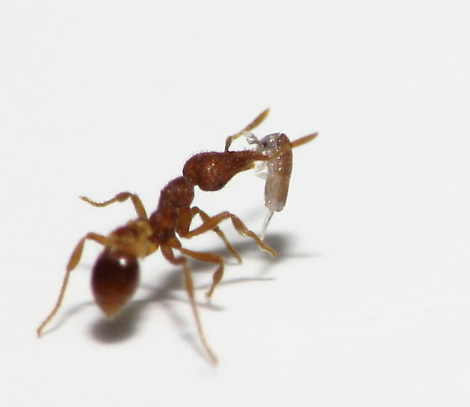
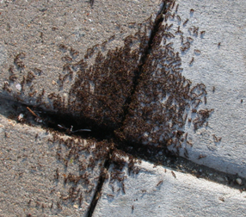
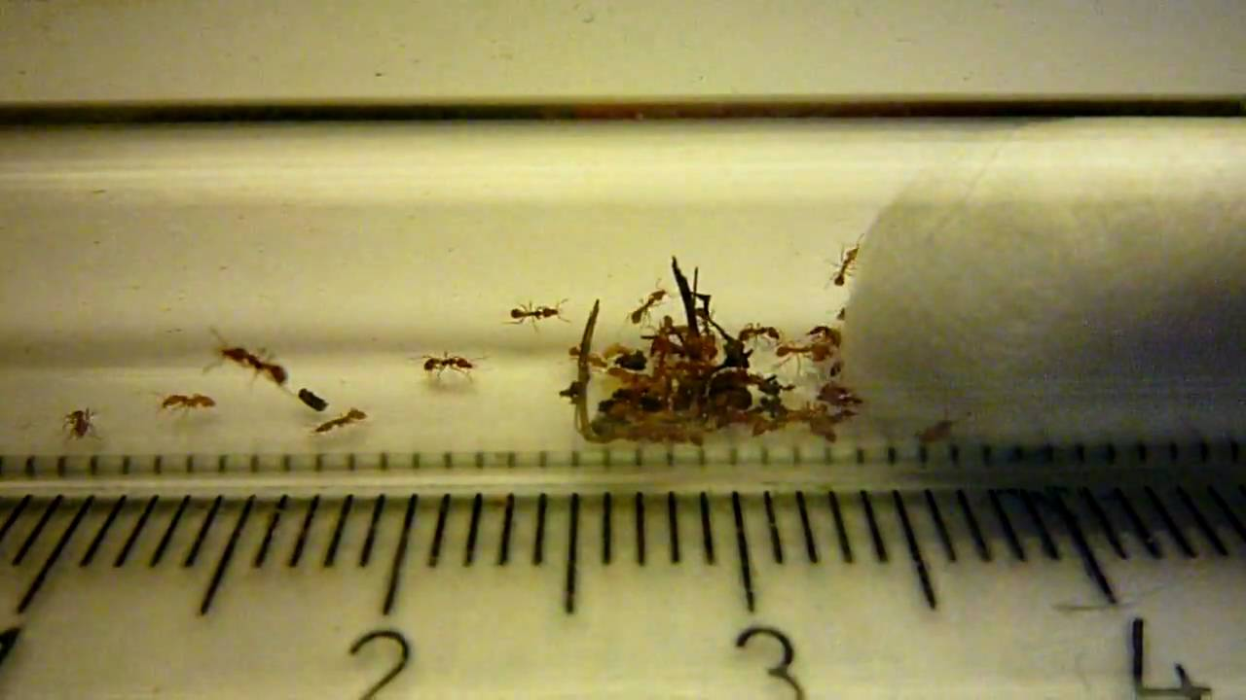
Saving Specimens/Photodocumentation - Taxonomy
Elucidating species taxonomy often relies on morphology of specimens – if you can’t save intact specimens, definitely take as high quality photos as you can!
Perfect!
Okay
Getting iffy
Bad

Slide 20
Saving Specimens/Photodocumentation – DNA
Also, novel sequences, of course, should not have a match in GenBank – to publish those sequences confidently, we’d need to retain vouchers.
Sometimes not enough variation!

Slide 21
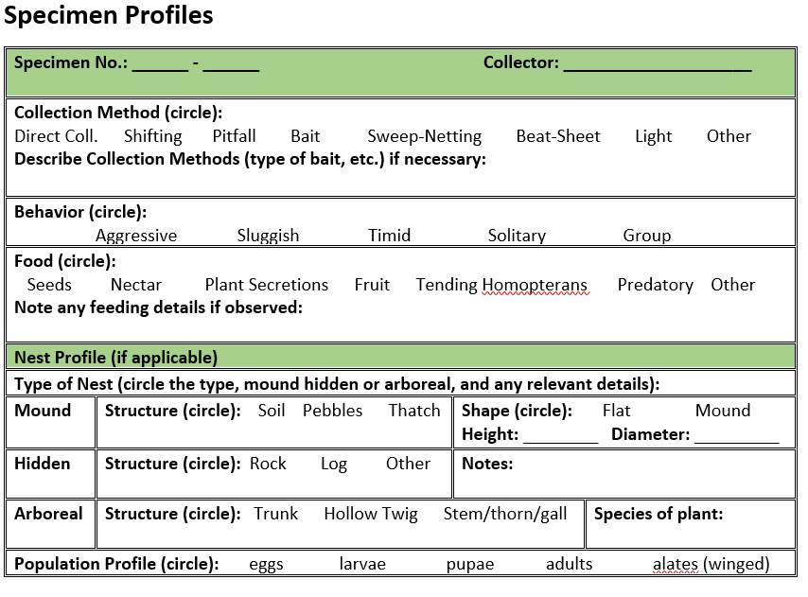
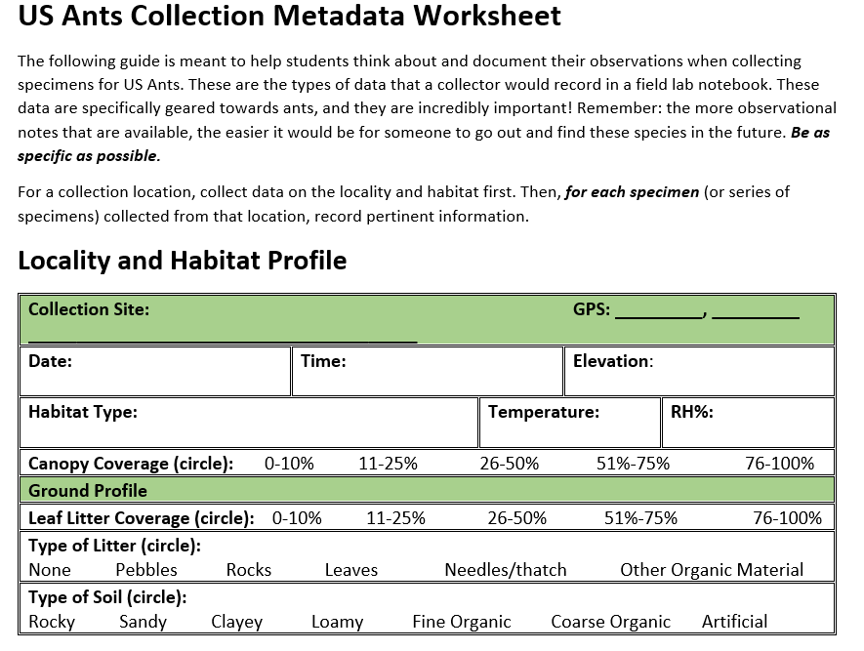
Metadata Collection

Slide 22
Tips for successful a project:
Spend time thinking about how to collect.
Stay organized – do not mix up samples/numbers/sequences
Be thoughtful about preserving/storing/documenting specimens – this is one of the most important foundational steps to the DNA barcoding.
Great quality sequence, undamaged voucher, and metadata to go along with it.

Slide 23
GOALS of US ANTS:
Acquire the tools and the experience of barcoding (really cool!)
Good data – don’t let interesting finds slip through the cracks (Hopefully, we get at least 100 novel sequences)
Great quality sequence, undamaged voucher, and metadata to go along with it.
3) Of course, have fun and be safe!

